Slide 1

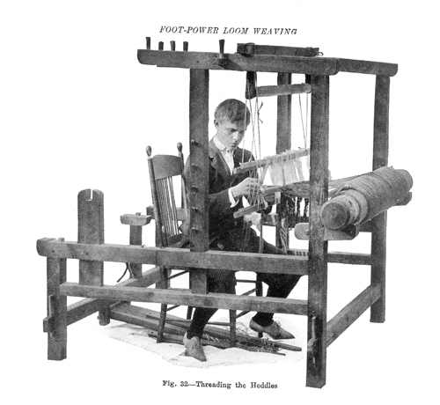
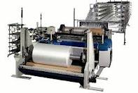
Presentation
On
Cronological Depelopment of Loom
Tee - 410
Project - 1

Slide 2

Introductory
Chronological development means step by step development, so chronological development of loom means the day by day or step by step development of loom. That mean the development of loom from invention to now. The chronological development of loom is given below as a flow chart & the details discussion also.

Slide 3
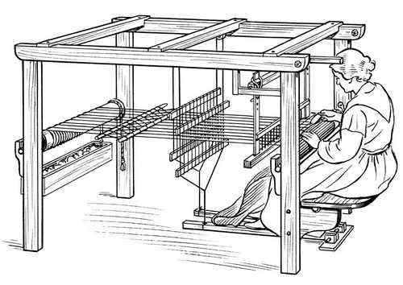
The chronological development of loom is given next as a flow chart & the details will also be discussed.

Slide 4

Chronological development of Loom
Primitive or vertical loom
Pit loom
Frame loom
Chittaranjan loom
Haatersely loom
Ordinary power loom
Automatic power loom
Modern loom
Fly Shuttle
2. Throw Shuttle
Semi automatic shuttle
Automatic loom
1. Projecttile 2. Rapier
3. Airjet 4. Water jet

Slide 5

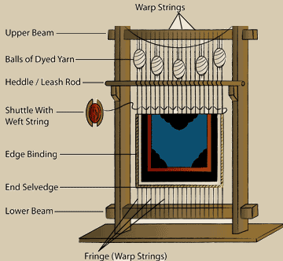
Vertical Loom
This loom is invented on Ancient Greek at 1900 B.C. This is the most conventional loom in weaving history. Before this there was weaving process but those process was not recorded & all of them r done by hand process. In this loom warp threads r vertically arranged from a horizontally attached bar & the shead is done by sheding rod & shed is changed by heedle rod & pickiking & beat-up is done by manually by weft bobbin & showrd. This the mechanism of Vertical loom.This style of loom is still used by the Navajo Indians, who picked up weaving from the Pueblo Indians far before the arrival of the Spaniards.

Slide 6
Pit Loom
This loom is invented in 1766 B.C. in Egypt.The weaver sits with his or her legs in the pit where there are two pedals which open the warp threads allowing the weft shuttle to pass through freely.This type of loom leaves the weavers' hands free to pass the weft shuttle through from side to side and to compress the weaving as they go. For this reason this type of loom also called throw shuttle loom.

Slide 7
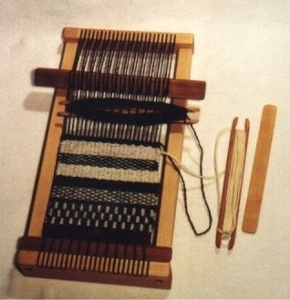
Frame Loom
Frame loom is also invented with pit loom. In this loom all weaving process is done within a frame that’s why it called frame loom. At first all the process is done by manually but with the development of technology all things are developed. This kind of loom use to make short length of fabric now-a-days.

Slide 8
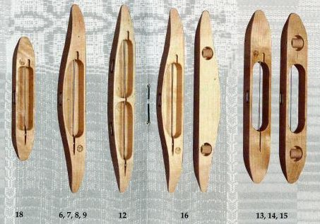
Throw Shuttle
Throw shuttle is that kind of shuttle which is passing between the shed by throwing with human from one side to another side. It was the most conventional or first types of shuttle used from the beginning of weaving.

Slide 9
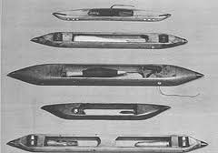
Flying Shuttle
The flying shuttle was invented by John Kay, an Englishman, in 1733 Kay invented a shuttle that was mechanically thrown. The weaver never touches the shuttle except to change the bobbin. This invention greatly sped up the weaving process and made it possible to weave much wider cloths.

Slide 10
Chittaranjan Loom
This loom is invented at 1734 in India. It was the simplest loom but the beginning time of modern loom after invention of this loom we develop the loom rapidly.

Slide 11
Hattersley Loom
Geo. Hattersley was a textile machinery manufacturer from Keighley, West Yorkshire in England, founded in 1789 and responsible for the Hattersley Standard Loom and other types of loom. Hattersley Dobby Loom In 1867 George Hattersley and Sons created a loom with a dobby head. A dobby a mechanical heald lifting device which allowed weaving of much more intricate patterns on any looms to which it was fitted.

Slide 12
Hattersley Loom
Hattersley Narrow Fabric Loom In 1908 Hattersley developed the world's first smallware (or narrow fabric) loom, these were suitable for weaving wicks for oil lamps, and the webbing that is used in the automotive industry. In 1919. Hattersley Domestic Loom. Which is mostly used for small domestic production. Hattersley Standard Loom In 1921 the Hattersley Standard Loom, designed and built by the company.

Slide 13
Ordinary Power Loom
A power loom is a mechanised loom powered by a line shaft. The first power loom was designed in 1784 by Edmund Cartwright and first built in 1785. It was refined over the next 47 years until a design by Kenworthy and `Bullough , made the operation completely automatic. This was known as the Lancashire Loom.

Slide 14
Automatic Power Loom
In 1820, Roberts completed the power loom, which became the basic model for modern looms thereafter In 1858, the Satsuma domain imported water powered looms from England in order to weave sail cloth In 1892, Shigejiro Matsuda perfected the foot operated loom. Four years later in 1896, Sakichi Toyoda invented Japan's first power loom called "the Toyoda Steam power loom". Automation continued to progress with the use of broken pick automatic stop units 1924, a series of improvements produced a revolutionary loom.

Slide 15
This was the continuous automatic shuttle change loom (model G automatic loom) invented by Sakichi Toyoda, which was the first of its kind in the world. This loom could automatically change the shuttle while operating at high speed without slowing down and had a unit for supplying the weft. After the Second World War Japan faced a serious labor shortage (1940-1950) more development pwriod of automatic power loom.

Slide 16
Modern Loom
After the 1960s, the goal of automatic loom manufacturers was to increase the speed of weft inserting and to reduce noise. Then a shuttle-less loom that does not use a shuttle was developed to replace the conventional shuttle loom. Methods of holding the yarn, such as the rapier loom and the projectile loom, spread rapidly. Then domestic water jet looms and air jet looms that use water or air to transport the yarn during weft insertion were produced domestically.

Slide 17
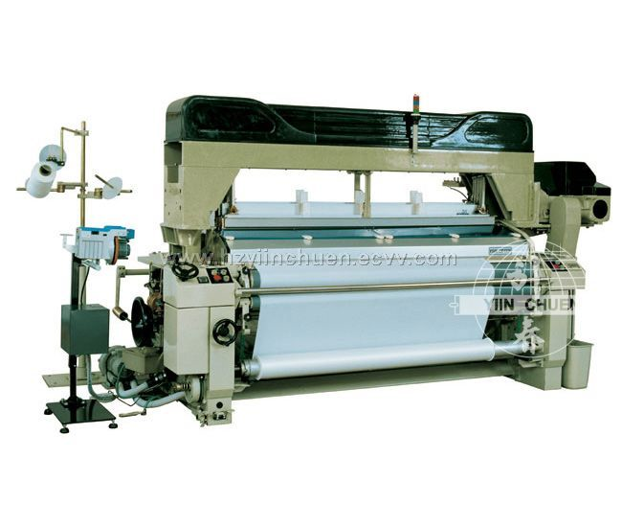
Modern Loom

Slide 18
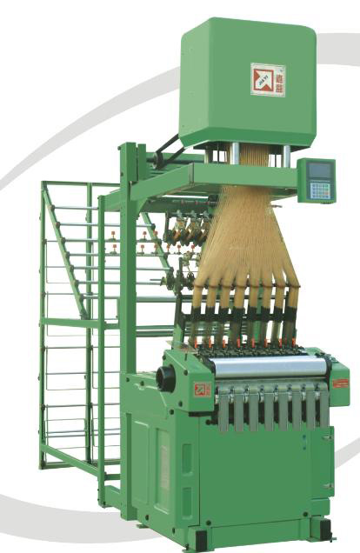
Jacquard Loom
Invention: jacquard loom invented in 1801.
Inventor: joseph marie jacquard
Definition: jacquard loom mechanism is controlled by recorder patterns of holes in a string of cards, and allows, what is now known as the jacquard weaving of intricate patterns.
Patent: The french government claimed the loom to be public property.

Slide 19
Conclution
Write Your Comments Here.

Slide 20

Thank You

